Slide 1

Cloud TECHNOLOGIES AND BIG DATA FRAMEWORKS
3rd Assignment – Covid-19 Cases in Italy 2020

Slide 2
Overview The dataset that has been retrieved contains a csv file that includes information regarding Covid-19 cases tracking back from 24-02-2020 until 11-04-2020. In this notebook I will conduct EDA on uploaded table using Data-Frames APIs and SQL query language, combined with Data Visualization to get a better insight on the data available to test. There won’t be data integration and further processing (train/test/split and cross validations) to implement ML algorithms to try test the accuracy of different predictive time series models, since the dataset is 2 years old.

Slide 3
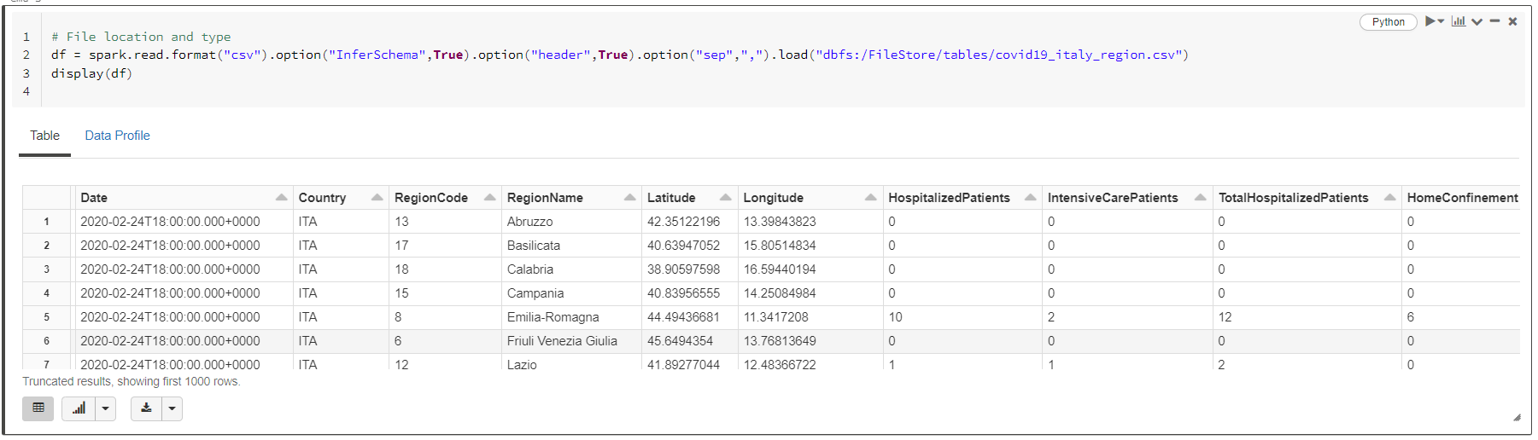
Uploading the Data
Initially two commands are executed. We want to see the file path in order to track the file that we want to upload and then we create a data frame with the name df.

Slide 4
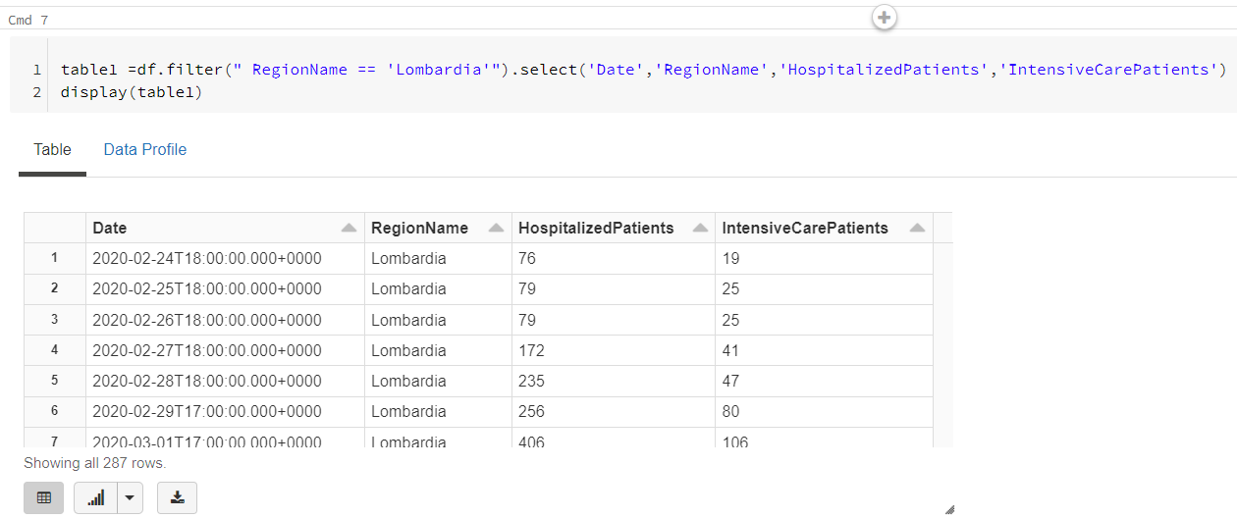
Test 1 First I want to filter my dataset to test and see for each day that data was collected how many of the patients that were hospitalized were categorized as intensive care patients for the region of Lombardia in Italy. Also get insight on how these number changed over time and create my second dataframe.

Slide 5
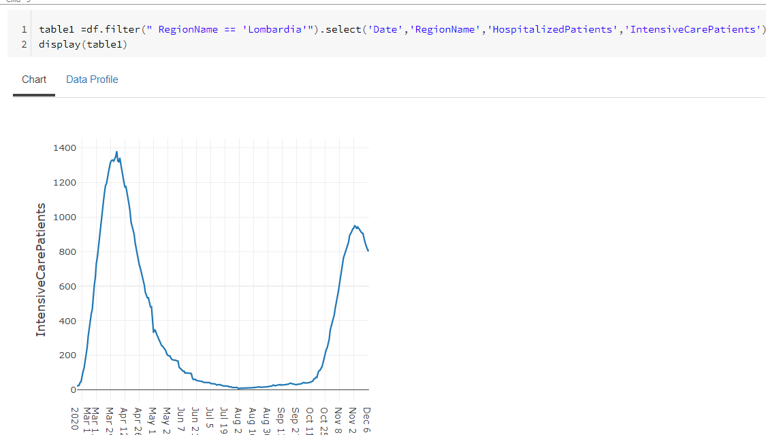
Graph 1 Graphical representation using a line graph (that is best suited for visualizing continuous time variables) to see how Intensive Care Patient's curve fluctuates over this time span

Slide 6
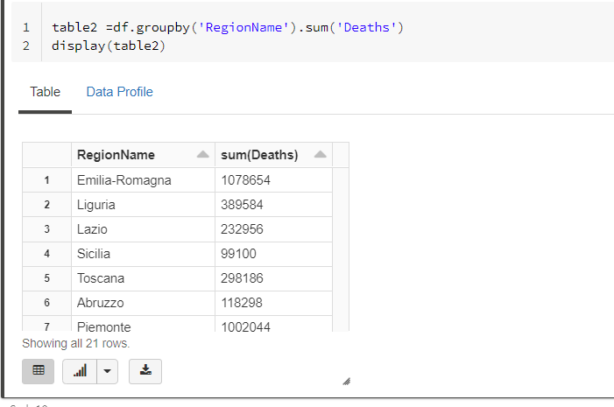
Test 2 Let’s say now that I want to compare the number of deaths recorded in all regions

Slide 7
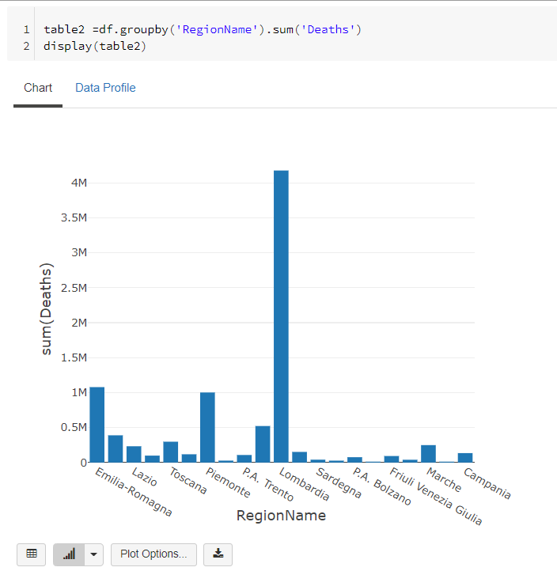
Graph 2 Use a bar chart to create a clear visual of the table2 dataframe created above to showcase the comparison between all Italy regions regarding the total number of deaths

Slide 8
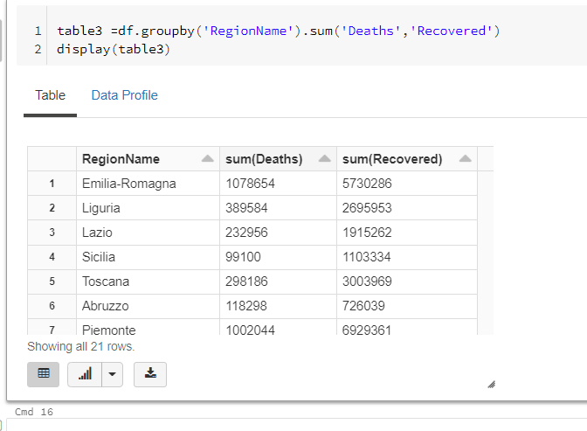
Test 3 Compare how many of the patients that were hospitalized managed to recover and what amount of these patients actually died, for all regions in Italy.

Slide 9
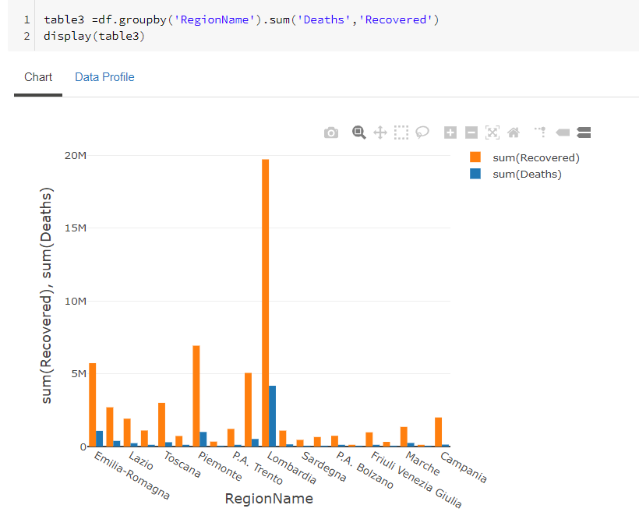
Graph 3 Graphical representation of the comparison between the total number of people that died and people that recovered with respect to the different regions.

Slide 10
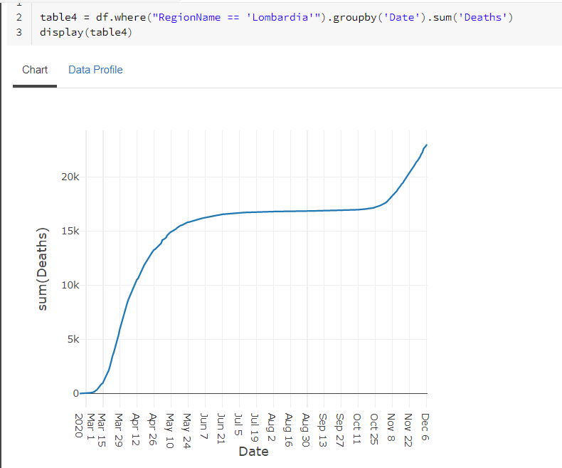
Test 4 Since we can see from the graph above that in Lombardia we have the largest number of deaths for patients that were hospitalized, we can further create another visual to see which time period we had the highest number of deaths occurred.

Slide 11
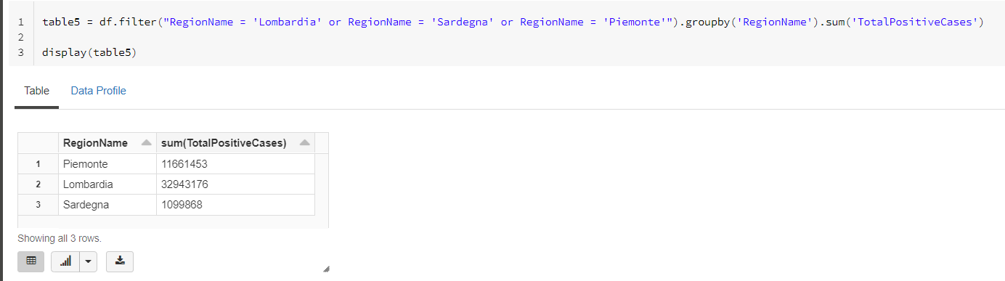
Test 5 Now we can compare the sum of total positive cases in the regions of Lombardia, Sardegna and Piemonte

Slide 12
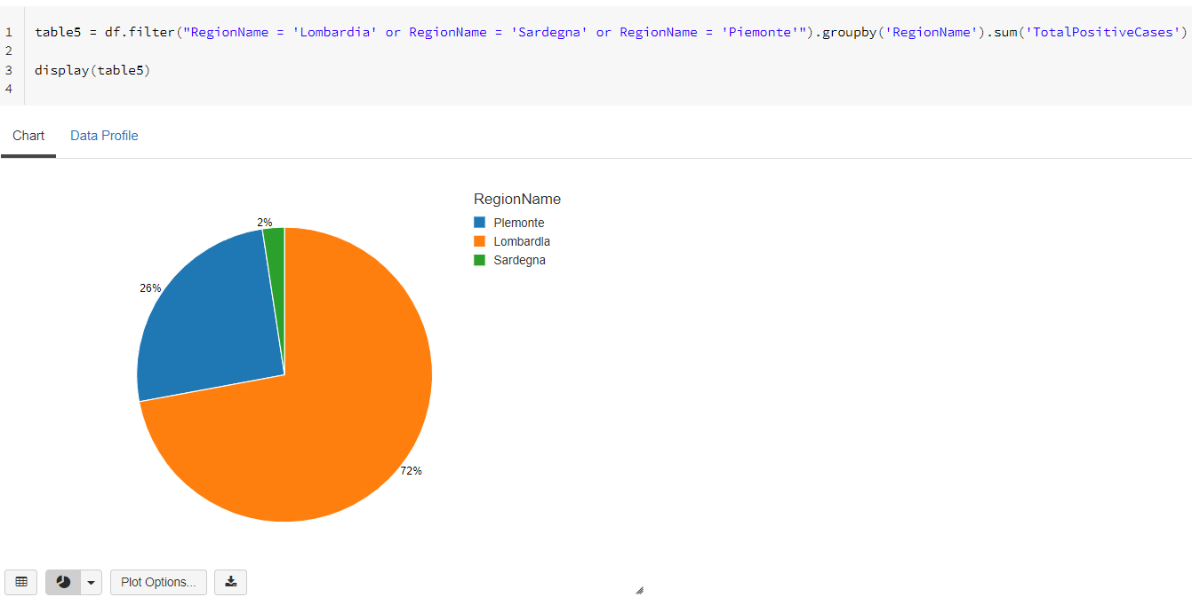
Graph 5

Slide 13
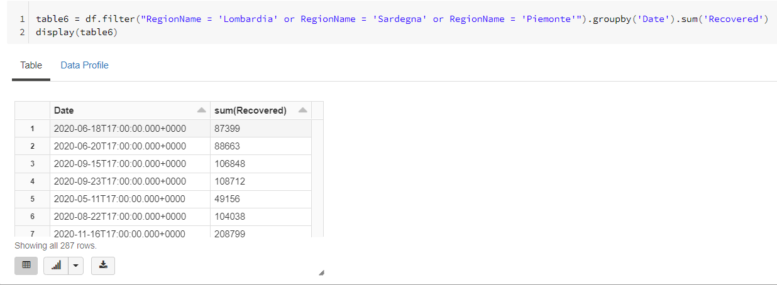
Test 6 Finally we are going to create a final chart to see the recovery rate of the total hospitalized patient over time for the specific regions mentioned above

Slide 14
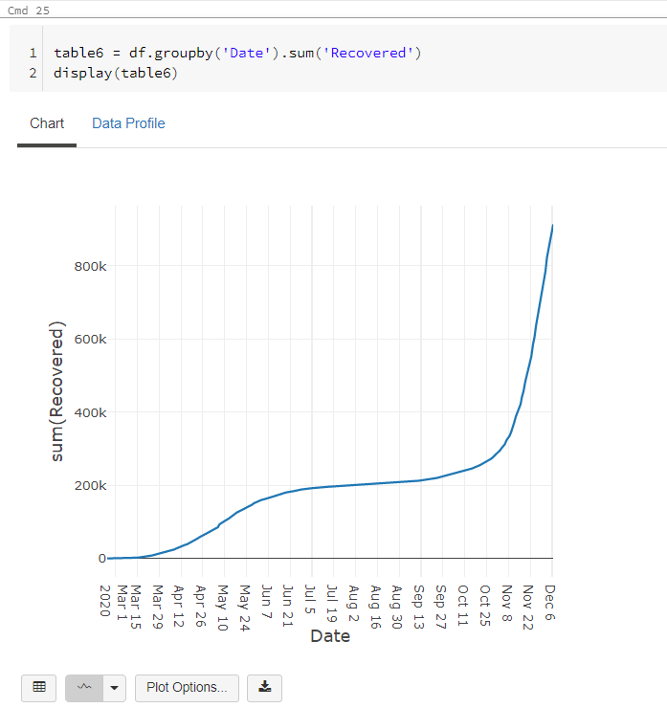
Graph 6

Slide 15
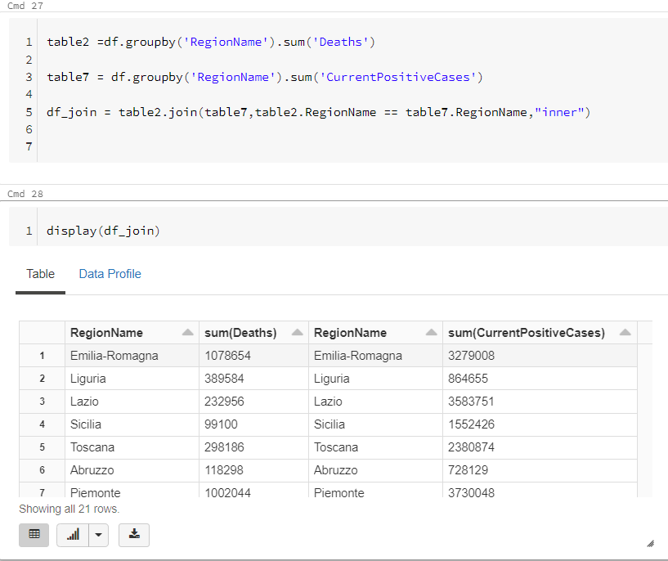
Test 7 Now we are going to create another table summing the total patients that were tested positive for each region and join it with the table2, in order to do the comparisons

Slide 16
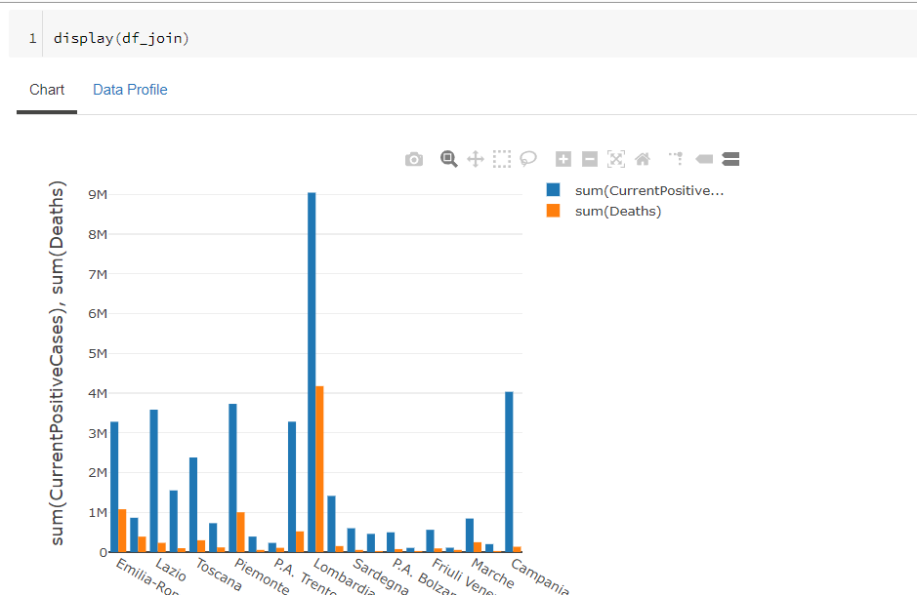
Graph 7 Graphical representation of df_join table created to display and compare for each region in Italy the sum of the total positive cases compared to the number of total deaths of people you were tested positive.

Slide 17
Thank you
Vasilios Philippou
Sofia Theochari

